Slide 1
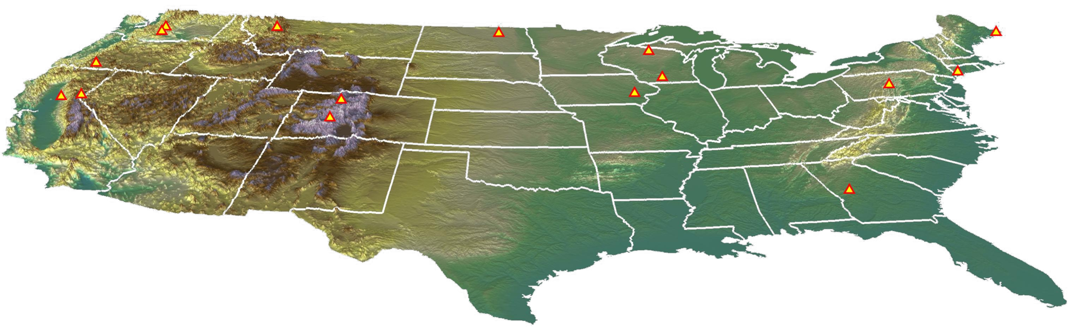

Workflow: Transient (Coupled) Models
Starkweather
Trout Lake
Cathance
Black Earth
Spring
Clear
Pomperaug
Flint
Modified from MODFLOW and More 2015 talk “Beyond Groundwater: Calibration and Uncertainty Analysis for Large Transient Coupled Models”
Randall J. Hunt¹, Marco D’Oria², Stephen M. Westenbroek¹, John Doherty³
¹US Geological Survey, Wisconsin Water Science Center
²Università degli Studi di Parma
³Watermark Numerical Computing

Slide 2
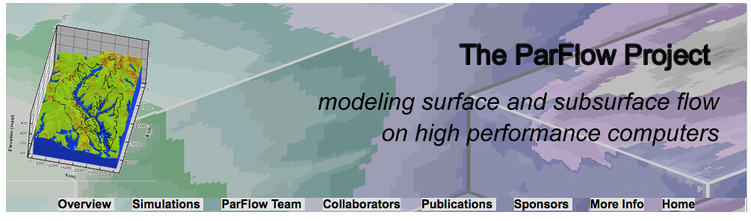


Are transient coupled models better if by coupling modern tools (e.g., parameter estimation) aren’t used?
More processes = more chances to interrogate uncertainty but more parameter correlation and insensitivity
More processes = longer runtime
More processes = more observations = more noise
https://computation.llnl.gov/casc/parflow/parflow_home.html
http://www.aquanty.com/hydrogeosphere/

Slide 3
Differences in observations and parameters
Integrated/Coupled model problems are different than groundwater problems
Parameters: many more different types (energy balance, soil zone, more reservoirs) = more degrees of freedom but more correlation between parameters, insensitivity, and threshold effects
Observations: many more of a given type (measurement noise concerns) but commonly provide redundant information
Upshot: Observations do not provide enough information/leverage to estimate parameters = signal-to-noise issues

Slide 4
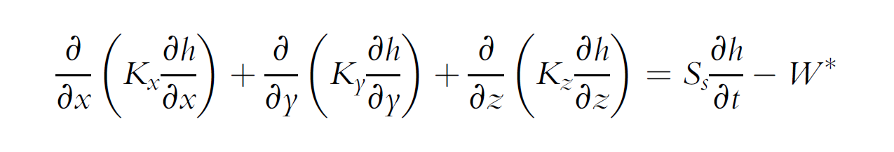
Anderson, Woessner, and Hunt (2015)
Storage for confined and unconfined layers are different.
Really different.
Max values typical of aquifer storage
5.00E-01
0.46
4.50E-01
4.00E-01
3.50E-01
3.00E-01
2.50E-01
2.00E-01
1.50E-01
1.00E-01
5.00E-02
1.00E-4
0.00E+00
confined storage
unconfined storage

Slide 5

Test bed: GSFLOW model
PRMS+MODFLOW-NWT
22-year simulation (12 year spin up)
Daily timestep
3-day forward runtime
Yes, we did use parameter estimation via high-throughput computing (see Fienen and Hunt 2015); this gives quantitative framework!
Hunt et al. (2013)

Slide 6
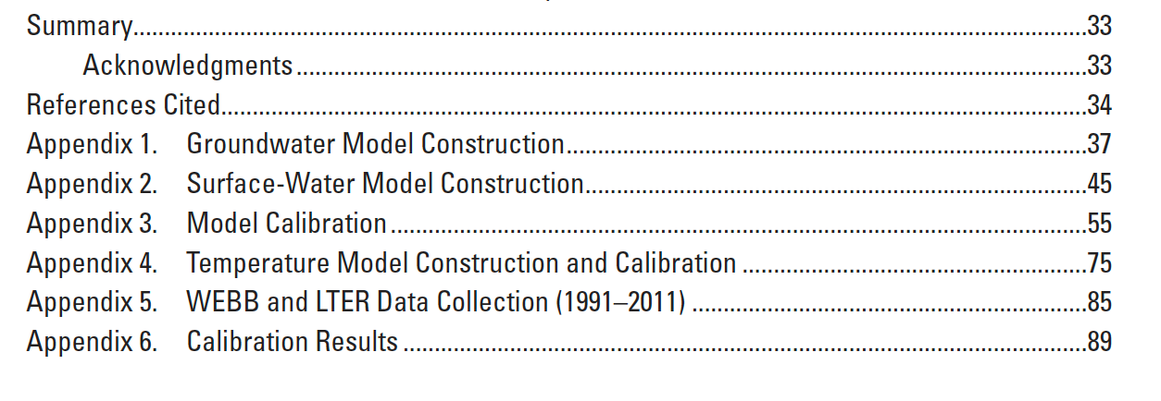
Test bed: GSFLOW model
PRMS+MODFLOW-NWT
29-year simulation (4-year spin up)
Daily timestep
4-hour forward runtime
Yes, we did use parameter estimation via high-throughput computing (see Fienen and Hunt 2015); this gives quantitative framework!
Hunt et al. (2013)

Slide 7
The need for speed: Stepwise Calibration uncoupled PRMS SW model
PRMS (transient)
PRMS (transient)
PRMS (transient)
Step 1
Solar radiation / ET
seconds to run
Step 2
Snow Pack
seconds to run
Step 3
Runoff / Infiltration
seconds to run
Why stepwise and not one objective function?

Slide 8
The need for speed: Next stepwise calibration paired simple/complex models e.g., Pre-calibration using sequentially linked models (Hunt et al. 2013)
PRMS (transient)
MODFLOW (steady-state)
utility
seconds to run average multiple years daily infiltration to ss recharge
seconds to run
1000’s observations
1000’s of parameters
seconds to run
1000’s observations
1000’s of parameters
parameter estimation

Slide 9
The need for speed: Final stepwise Calibration Coupled GSFLOW model
GSFLOW (transient)
Focus on parameters that couple PRMS to MODFLOW
hours to days to run

Slide 10
One good workflow: calibrate ss first, then transient
Steady state models run faster , more parameters can be estimated for same time
For transient models, changing storage can have similar effects as changing K. Decoupling estimation breaks the correlation.
Steady state models do not have storage parameters, so stronger signal for information transfer from observations to K parameters
In turn, transient model calibration can focus on storage, not K (=fewer parameters)
Or put another way:
If K was optimal for the ss model any changes to K during transient calibration will degrade ss calibration. If we can get an acceptable calibration for the transient model using only storage we can preserve the steady state calibration optimality
Notes:
*

Slide 11
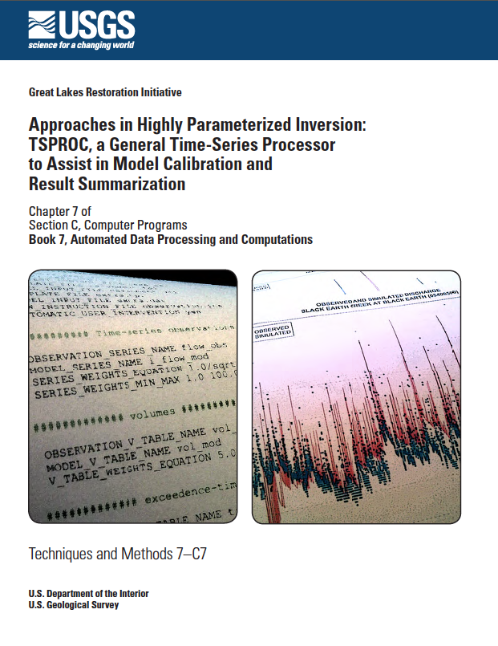
Increasing the signal-to-noise ratio
Time series processing of observations and model outputs (e.g., TSPROC Westenbroek et al. 2012)
Identifiability
Superobservations

Slide 12
Increasing the signal-to-noise ratio
TSPROC (Westenbroek et al. 2012)
Port of Doherty’s Time Series processor
Fast (fortran)
Two modes:
Create PEST observations/files
Post-process model output
Wide variety of processing – flow duration, temporal differencing, IHA, baseflow separation (low pass filter)
IMPORTANT: “Apples to Apples comparison”

Slide 13
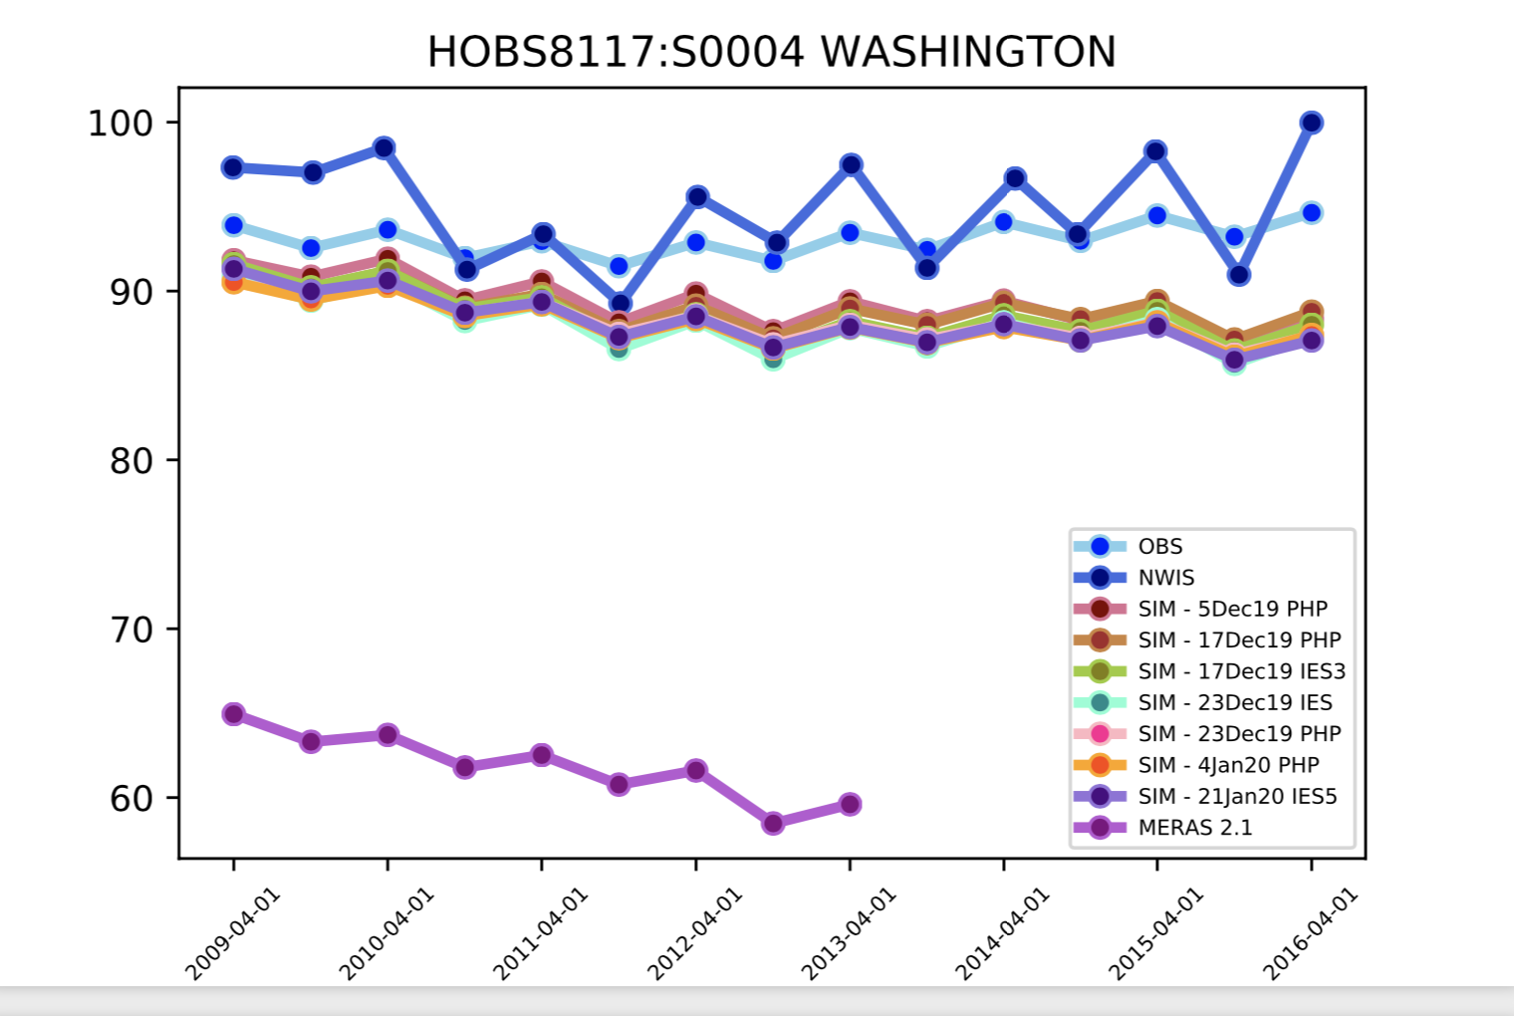
orange
apple
apple
apple

Slide 14
First step to transient modeling
Plot the observed data over time
This gives you and idea of what the model is supposed to fit
Plot smoothed versions of the observations over time
This gives you an idea of what the model

Slide 15
Increasing the signal-to-noise ratio
Time series processing of observations and model outputs (e.g., TSPROC Westenbroek et al. 2012)
Identifiability
Superobservations

Slide 16
10.0
GSFLOW Parameters: 37 sensitive parameter according to Log Composite Scaled Sensitivities
1.0
0.1
0.01
0.001
.0001
vksat
bc-eps
surfdep
sy
ss
kh1mult
kh2mult
kh3mult
kh4mult
kv1mult
kv2mult
kv3mult
den_init
den_max
jh_coef
thetasfac
crad_coef
crad_exp
albset_rna
radj_wppt
radj_sppt
cecn_coef
ccov_intcp
albset_sna
ppt_rad_adj
tmax_rain1
fastcoef_sq
albset_snm
tmax_rain2
slowcoef_lin
ssr2gw_exp
carea_max
jh_coef_hru
ssr2gw_rate
fastcoef_lin
ccov_slope
smidx_exp
albset_rnm
smidx_coef
freeh2o_cap
adjmix_rain
imp_sto_max
pref_flw_den
slowcoef_sq
transp_tmax
potet_sublim
settle_const
snowinf_max
tmax_allsnow
ssrmax_coef
after Doherty and Hunt (2009)

Slide 17
Just because a parameter is sensitive is it identifiable? No.
-gage constrains 8 of 46
-gage has NO information for 27 of 46
Need more/different calibration data!
after Doherty and Hunt (2009)
Notes:
17

Slide 18
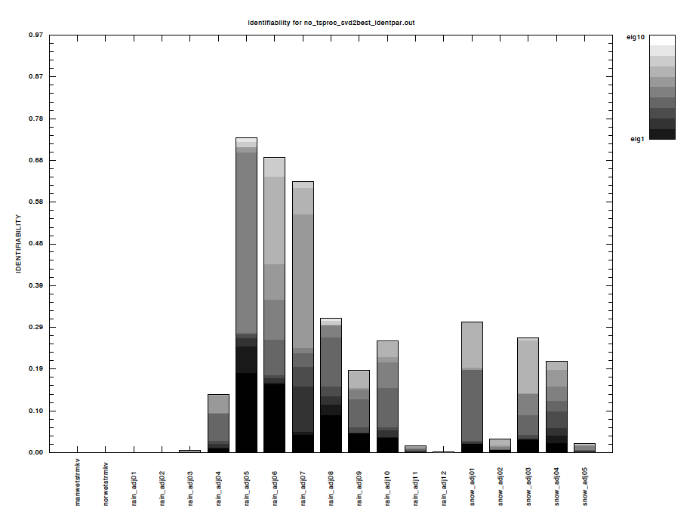
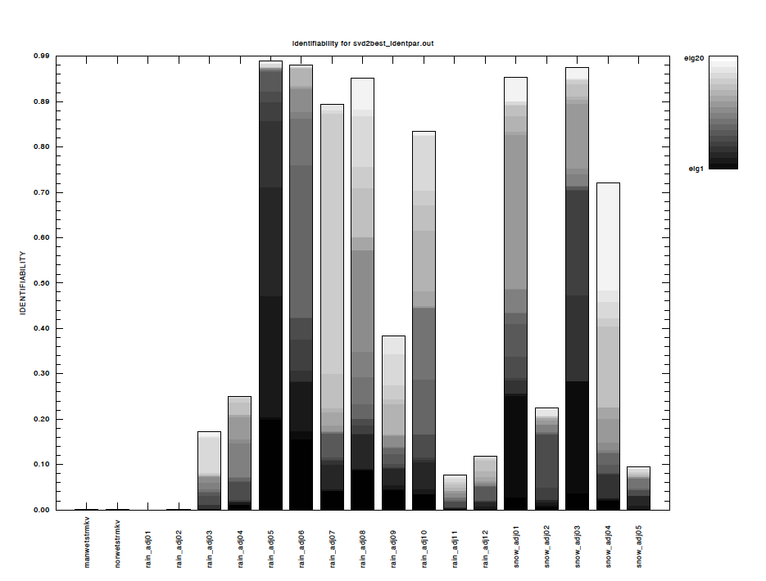
Adding time-series processing to raw observation data: Identifiability
No time-series processing
(observations support 10 singular values)
With time-series processing
(observations support 20 singular values)

Slide 19
Handling parameter correlation and insensitivity Truncated SVD and superparameters
S⁻¹ U^{t}₁h = V^{t}p
singular values
parameters
Notes:
19

Slide 20
Upping signal-to-noise ratio using “superobservations”
S⁻¹ U^{t}₁h = V^{t}p
singular values
observations
Analytical tool: Superobservations can be directly mapped back to superparameters = relates to information content
Notes:
20

Slide 21
Visualizing signal-to-noise ratio using superobservations
7.00%
6
6.00%
5
5.00%
4
4.00%
Percent of dominant singular value
Streamflow (cfs)
3
3.00%
2
2.00%
1.00%
1
0.00%
0
1
8
15
22
29
36
43
50
57
64
71
78
85
92
99
106
113
120
127
134
141
148
155
162
169
176
183
190
197
204
211
218
225
232
239
246
253
260
267
274
281
288
295
302
309
316
323
330
337
344
351
358
365
372
379
386
393
400
407
414
421
428
435
442
449
456
463
470
477
484
Day
Hunt et al. (2009)
Notes:
21

Slide 22
Automated superobservations (PEST utility supobsprep.exe)
2.5E+04
2.08E+04
2.0E+04
1.5E+04
Total Phi
1.0E+04
5.0E+03
0.0E+00
14,411 observations (Hunt et al. 2013)

Slide 23
Automated superobservations (PEST utility supobsprep.exe)
2.5E+04
2.27E+04
2.08E+04
2.0E+04
50 obs! Great for adjoint state methods!!!
1.5E+04
Total Phi
1.0E+04
5.0E+03
0.0E+00
14,411 observations (Hunt et al. 2013)
50 superobservations

Slide 24
Automated superobservations (PEST utility supobsprep.exe)

Slide 25
Automated superobservations (PEST utility supobsprep.exe)

Slide 26
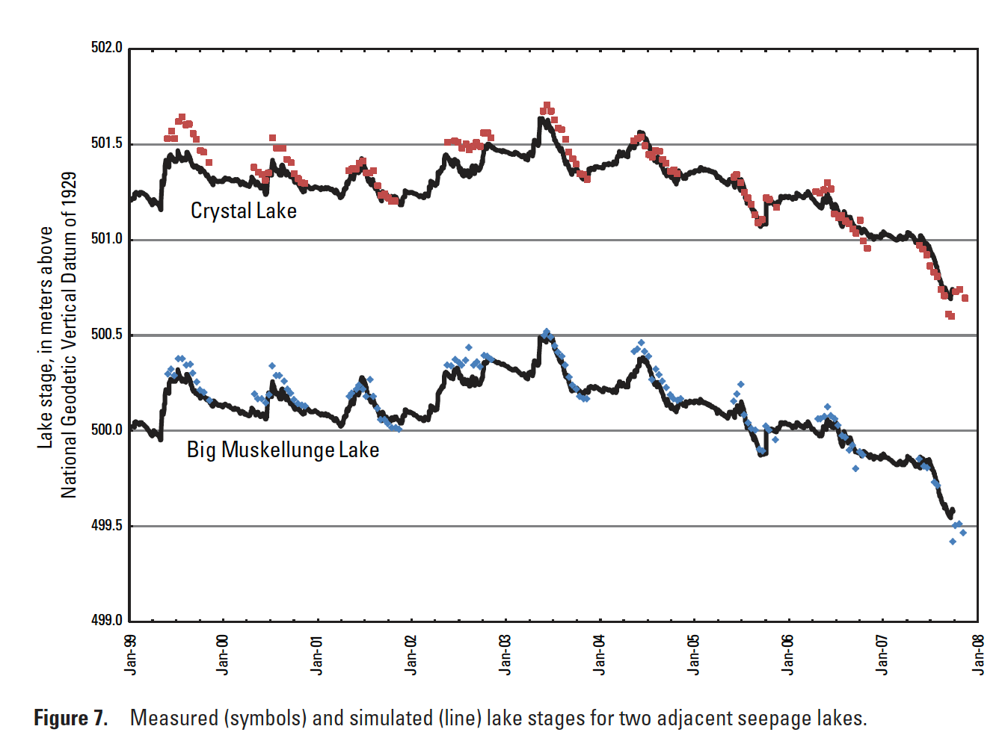
Why time series processing (t₂-t₁) is key

Slide 27
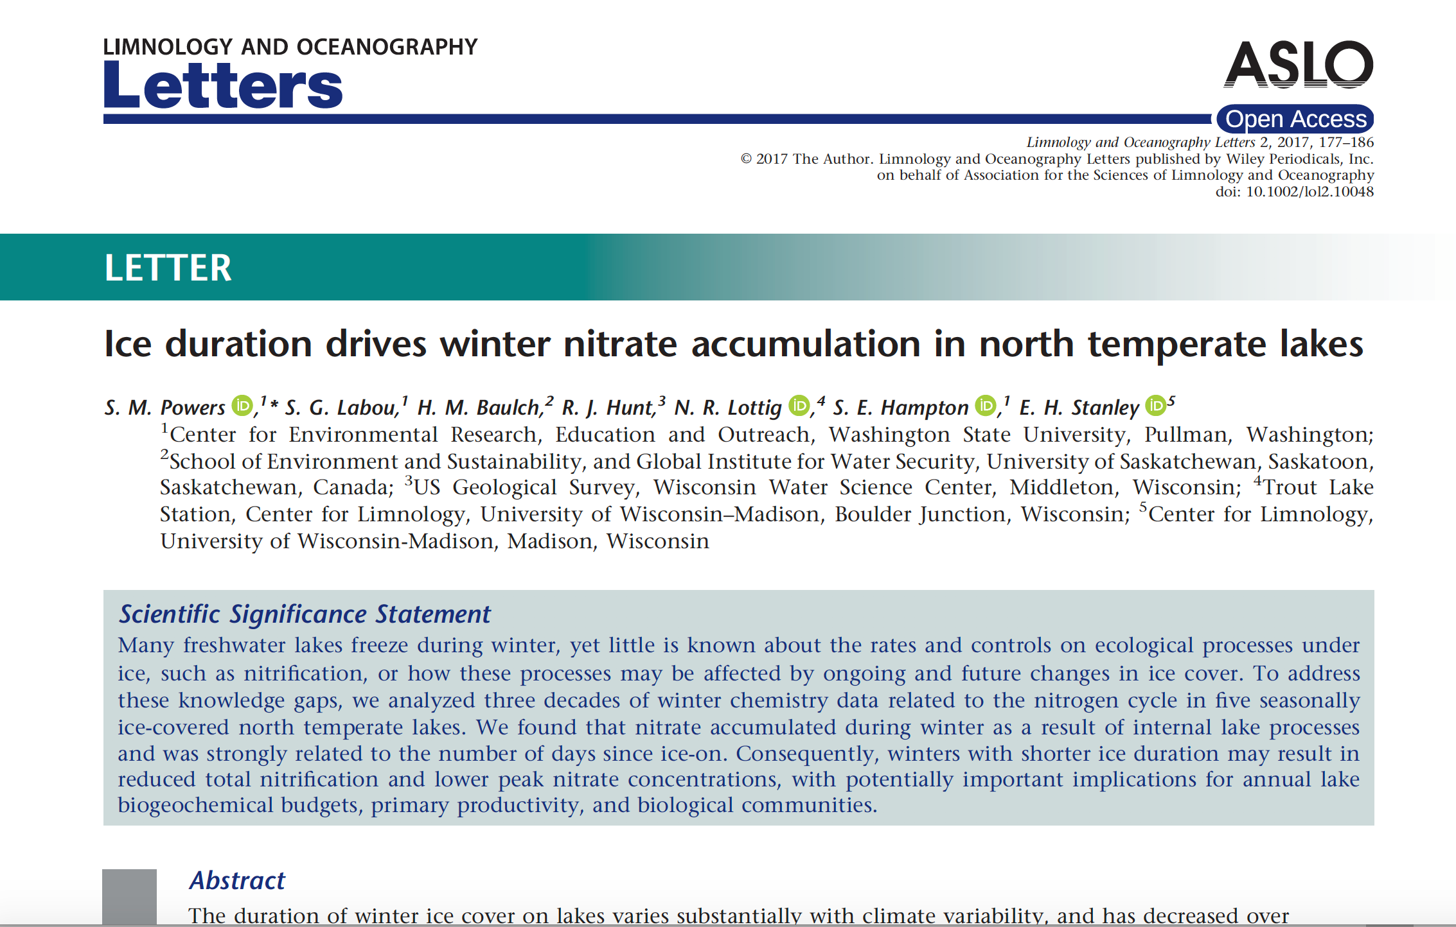
The Upshot on calibration
Integrated models are important for answering societally relevant question but giving up critical insight provided by modern tools like parameter estimation is problematic
We’re going to have to do additional work to bridge this gap (=do more than couple in parallel)
Using paired complex/simple models is an area with promise
Ensembles too!

Slide 28

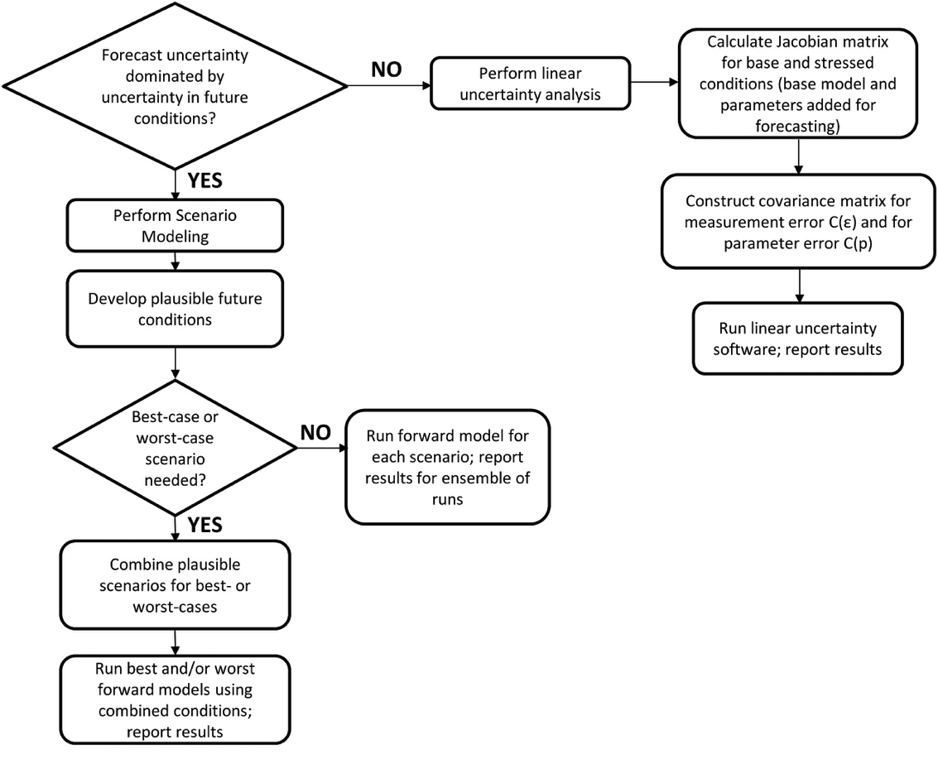
What about Uncertainty Analyses? (warning: shameless plug coming)
Basic Uncertainty flow chart Figure 10.6

Slide 29
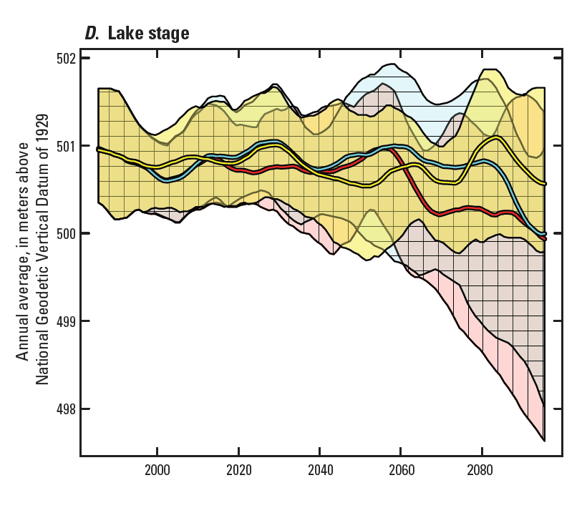
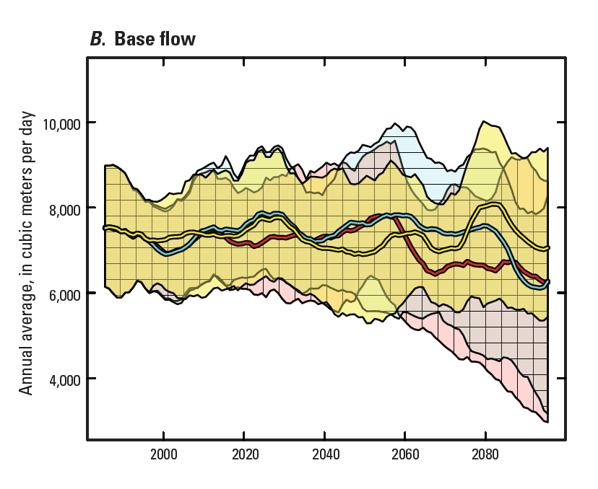
The Upshot on Uncertainty

